Slide 1
DIRECTORATE GENERAL FOR INTERNAL POLICIES
LEGAL AFFAIRS
The (Not Enough Directive)
Mediation Directive of 2008

Slide 2
Directive 2008/52/EC: A ten-year-long mediation paradox
Mediation: much talked about, yet after 10 years 99% of civil and commercial cases still go only through court litigation
No "balanced relationship" between mediation and judicial proceedings (as required by Article 1)
Tens of billions of Euros lost every year by EU businesses and citizens (Rebooting study, 2014)
General taxation continues to shoulder majority of costs of civil litigation system (court fees cover, on average, just 25%)
Conflict as a “growth industry”: the hidden costs of “non mediation”
2

Slide 3
The mediation paradox solved: in the eu (in part) and nearby (in full)
Italy has between 15 and 20 times as many civil and commercial mediations as any other EU Member State
Where used, mediation has cut new cases by 30% on average, reaching up to 49% in certain sectors
Mediation used only in 15% of civil litigation: no significant nr. of mediations, nor any reductions of new cases, in the balance of 85%
Turkey has adopted the Italian mediation model as of January 2018 for employment disputes
From 13k to 200k mediated disputes per year
Success rate of 67%
Reduction of incoming cases greater than in areas where mediation does not apply
Mediation rules to be extended to the majority of commercial disputes as of January 2019
3

Slide 4
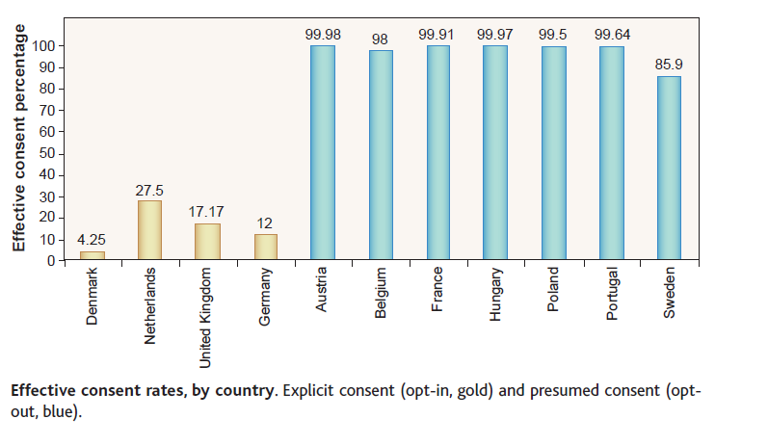
SAVING, SIMPLY, MANY MORE LIVES
By Eric J. Johnson and Daniel Goldstein https://www.academia.edu/5104501/Save_default_save_life

Slide 5
Opt-In vs. opt-out (Learning from Nobel Prize winners)
Daniel Kahneman (2002) "for having integrated insights from psychological research into economic science, especially concerning human judgment and decision-making under uncertainty"
Richard Thaler (2017) {co-author of “Nudge – Improving Decisions about Health, Wealth and Happiness”} for his contribution to Behavioral Economics, “exploring the consequences of limited rationality, social preferences, and lack of self-control” and “how these human traits systematically affect individual decisions as well as market outcomes”
“Nudging” (not obliging!) people so that they try to mediate more

Slide 6
THE MEDIATION DIRECTIVE LACKS IN … DIRECTIVENESS
Article 5(2):
“This Directive is without prejudice to national legislation making the use of mediation compulsory or subject to incentives or sanctions, whether before or after judicial proceedings have started, provided that such legislation does not prevent the parties from exercising their right of access to the judicial system.”
Mediation quality, confidentiality and enforceability necessary, but not sufficient (Rebooting study, 2014)

Slide 7
A «CULTURE OF SAFE DRIVING»: WOULD THAT ALONE BE SUFFICIENT?
Video meliora proboque, deteriora sequor (“I see and approve of the better, but I follow the worse” – Ovidius, born 43 BC)

Slide 8
CJEU (2010): MORE EFFICIENT SOLUTION IS REQUIRING MEDIATION
“ … the introduction of an out-of-court settlement procedure which is merely optional is not as efficient a means of achieving those objectives”
“… is not binding … does not cause a substantial delay … suspends the period of the time-barring of claims … is free or very low cost …”
Source: 18 March 2010 (Joined Cases C‑317/08, C‑318/08, C‑319/08 and C‑320/08)

Slide 9
EU PARLIAMENT MISSED CHANCE TO ADOPT OPT-OUT MEDIATION MODEL IN 2014 AND 2017
“Member States shall ensure that a mediation session is integrated into the judicial process for civil and commercial cases, except for such cases as Member States shall determine are not suitable for mediation. The minimum requirements for such a mediation session are that the parties must meet together with a mediator, subject to the condition that the procedure shall be non-binding, swift, suspend the period for time-barring of claims, and be free of charge or of limited cost if any party decides to opt-out at the initial session”.
National legislators left without guidance as to how to make mediation eventually happen (eg, Romania and Greece; Belgium and France)
Most EU citizens and businesses left without the multiple benefits deriving from greater use of mediation

Slide 10
Presentation by
Giuseppe DE PALO
Ombudsman for United Nations Funds and Programmes, Professor of Alternative Dispute Resolution Law and Practice at Mitchell Hamline School of Law, St Paul, U.S.A
Briefing note written with the assistance of:
Leonardo D’URSO, Italy
Constantin Adi GAVRILA, Romania
Giovanni MATTEUCCI, Italy
Elena KOLTSAKI, Greece
Mary B. TREVOR, U.S.A.
Policy Department Citizens’ Rights and Constitutional Affairs
Responsible Administrator: Roberta PANIZZA
poldep-citizens@europarl.europa.eu

